Slide 1
🎙
Audio Transcription Automated Module
Powered by Gemini AI · FFmpeg
MP3 · WAV · M4A ·
speechtoscript.netlify.app

Slide 2
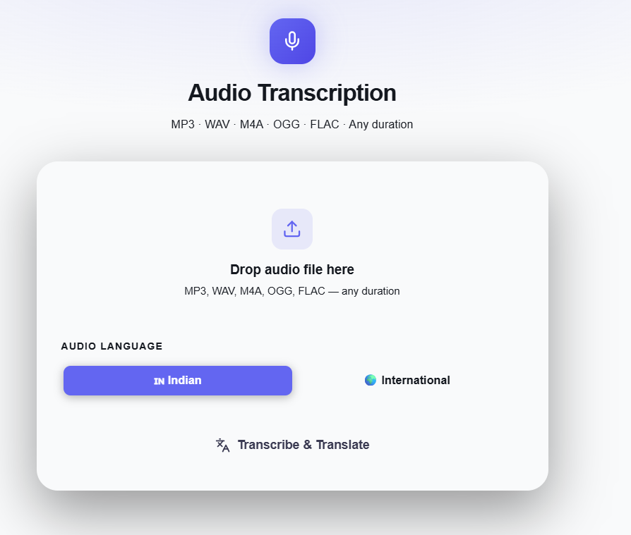
🎙
Upload Interface
🗂
Drag & drop audio file
🌐
Indian or International language
▶
One-click Transcribe & Translate
Accepted formats
MP3 WAV M4A

Slide 3
System Architecture
End-to-end pipeline: Upload → Split → Transcribe → Merge → Display
Client
Browser
FastAPI
Router
FFmpeg
Split
Gemini
API
Merge
Results
Web Page
Display
▶
▶
▶
▶
▶
Audio upload
SSE stream
10 min chunks
segments
Show output
User Upload Audio
Auto Splitting
Auto Split upload
Auto Transcribing
Auto Merging of transcribed segments
Result ✓
Web Page Output
📄 Original text (native script)
🌐 English translation
Speaker labels · Filler words · [unclear] / [silence]
Moderator / Interviewee labels · English

Slide 4
APIs & External Dependencies
End-to-end pipeline: Upload → Split → Transcribe → Merge → Display
Gemini
API
Gemini Files API
▶
Model: gemini-3-flash · temp 0.1 · 5 min timeout · retry ×3
Transcribe and Translate
Google Cloud Console — Billing ($0.5 /1hr audio; $0.0075 /min)
No payments done yet
Beyond 1-hr testing pending
Testing to be done post payment
Web Page
Display
Hosting – Netlify , Render — Billing post free-tier credits
▶
Frontend - React Backend - Python
Show output

Slide 5
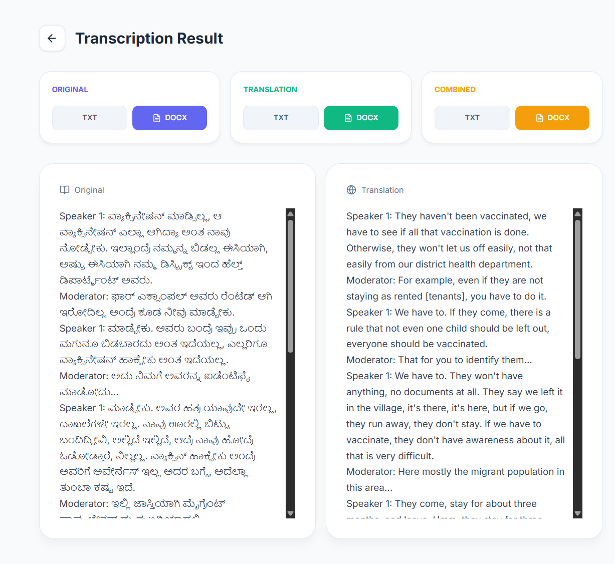
✓
Transcription
Result
Original
📄
Native script with
speaker labels
Translation
🌐
English with speaker labels
Combined
📎
Both in one
downloadable file
Export as DOCX

Slide 6
Key Features: Automation of Audio Transcription
🎙
Any Audio Format
✂
Smart Chunking
🌏
Multilingual
MP3, WAV, M4A
10-min chunks with 60s overlap — no speech lost at boundaries
Detects language automatically — Indian & international
📡
Live Progress (SSE)
📥
Export DOCX
Real-time percent updates of each progressing phase
Download original language transcription, English translation, or combined.

Slide 7
🎙
Transcribe & Translate
Audio, Any Language
speechtoscript.netlify.app

